Slide 1
PROG6212 POE
ST10439216
CUAN OOCK
POWER POINT PRESENTATION

Slide 2
What is this POE
For this POE, the task was to create a claim system. This system is intended for academic managers and programme coordinators to approve overtime pay for lecturers.
The project uses Microsoft Identity, Entity framework core, and .net infrastructure to do this
Identity is used in this application to assign roles to all parties involved
This includes an HR role

Slide 3
Newly added HR role
The HR role can add users through identity, as well as assign them roles to those new users
HR can also export all claim Data into a csv file
The role of the programme coordinator is to reject or forward claims from lecturers to the academic manager.
The academic manager then finally approves or rejects the claim

Slide 4
Application Flow
Before the presentation explains the flow, here is a demonstrational video of the application, as well as the applications github (Also included in the word doc and readme file).
Youtube: https://youtu.be/ptZxu7fDj5w
Git: https://github.com/OockCuan/PROG6212POE.git

Slide 5
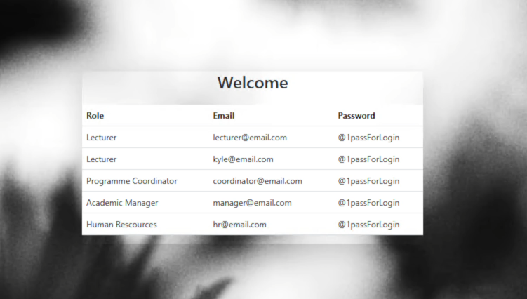
Application Flow
Here is the application home page
As my lecturer feedback suggested I use bootstrap, I added more bootstrap to the code as well as a very small amount of css to make the home page elegant with a background image
The image shows all roles in the order the claims flow
Lecturer>Coordinator>Academic Manager>HR

Slide 6
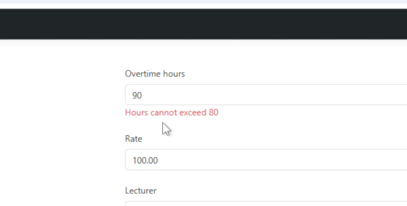
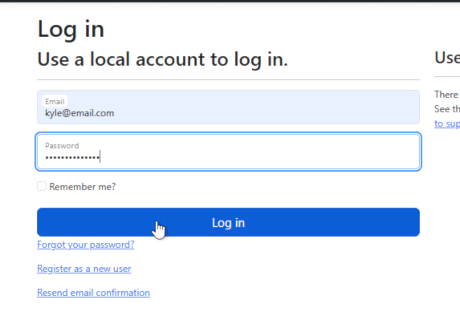
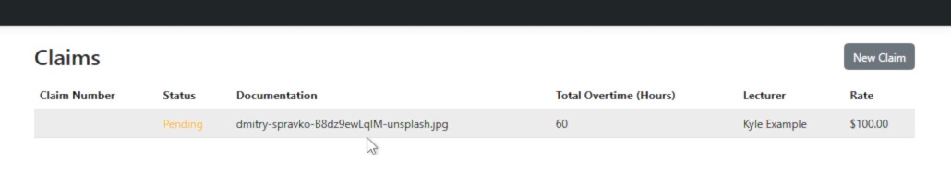
Lecturer and Login
After a user logs in, they get access to the relevant workflow that they must complete
For a lecturer they can view their own claims, or create new ones
Lecturers overtime rates are automatically set as they are stored in the database

Slide 7
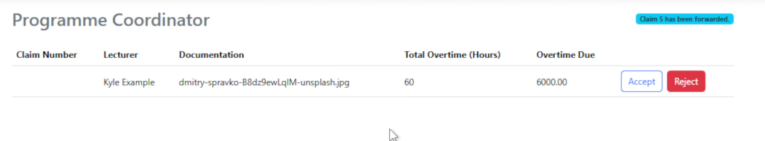
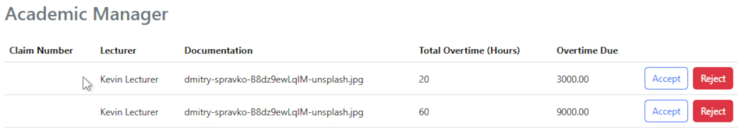
Coordinator And Manager
Programme coordinators review claims that have already been through the validation that comes with the lecturer claim form. They will then either reject it or forward to the academic manager
The academic manager can then approve or reject the claim as well

Slide 8
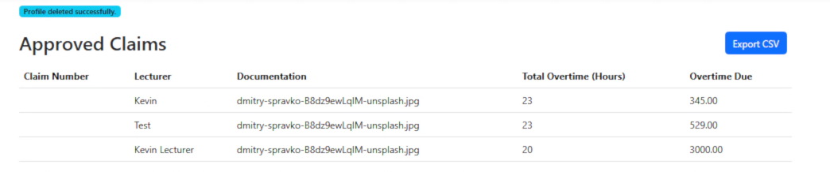
HR
Lastly, HR can view all approved claims, export them to a csv and create employee profiles
(all profiles and profile creation shown in next slide)

Slide 9
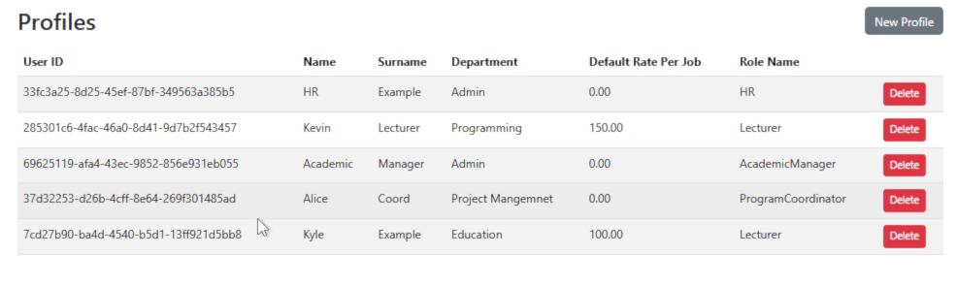
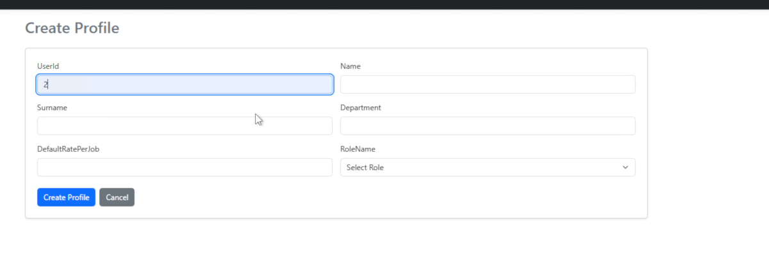

Slide 10
Design choices
From part 2 to the final POE I've made a few design tweaks
Firstly, the home page is more welcoming with the welcome in the center and a background images of flowers is used
The theme for it was changed from using many bright colours to a simple black, grey, white and occasionally other colours to signify importance of certain prompts (such as the status of the claims)
Lastly button placements are slightly different to put them in a slightly more clear position

Slide 11
References
Dave, StackOverflow (2016). Asp.net core Identity "The INSERT statement conflicted with the FOREIGN KEY constraint ". [online] Stack Overflow. Available at: https://stackoverflow.com/questions/41280345/asp-net-core-identity-the-insert-statement-conflicted-with-the-foreign-key-cons [Accessed 21 Nov. 2025].
‌ Wilander, J. (2025). Cityscape at dusk with illuminated buildings and sunset sky. [online] Unsplash.com. Available at: https://unsplash.com/photos/cityscape-at-dusk-with-illuminated-buildings-and-sunset-sky-r_tZ7moJluA [Accessed 21 Nov. 2025].
‌ S, L. (2025). Blurred black and white flowers against bright sky. [online] Unsplash.com. Available at: https://unsplash.com/photos/blurred-black-and-white-flowers-against-bright-sky-0H8WkXxNun0 [Accessed 21 Nov. 2025].
‌ freeCodeCamp.org (2025). Stop a Page from Scrolling. [online] The freeCodeCamp Forum. Available at: https://forum.freecodecamp.org/t/stop-a-page-from-scrolling/745917 [Accessed 21 Nov. 2025].
W3schools.com. (2025). W3Schools.com. [online] Available at: https://www.w3schools.com/cssref/pr_background-image.php [Accessed 21 Nov. 2025].
‌ Trust Jamin Okpukoro (2025). CSS background image: How to add and customize it — developer guide. [online] Uploadcare Inc. Available at: https://uploadcare.com/blog/css-background-image-how-to-add-it/ [Accessed 21 Nov. 2025].
Questpdf.com. (2020). QuestPDF | C# PDF Generation Library. [online] Available at: https://www.questpdf.com/ [Accessed 21 Nov. 2025].

